Slide 1

AWS Deployment & Management Services
Lesson 07: AWS Deployment & Management service
Notes:
Add instructor notes here.

Slide 2
Lesson Objectives
In this lesson, you will learn:
Amazon Elastic Beanstalk
AWS CloudFormation
Amazon Cloudwatch
Codebuild
CodeDeploy
Notes:
Amazon Elastic Beanstalk
AWS CloudFormation
Amazon Cloudwatch
Codebuild
CodeDeploy
This lesson is to give an Introduction on Java Server Pages

Slide 3

7.1: Amazon Elastic Beanstalk Amazon Development tool Service
The AWS Developer Tools is a set of services which is designed to enable developers and IT operations professionals to implement DevOps to rapidly and safely deliver software .
These services help to securely store and version control the application's source code and automatically build, test, and deploy the application to AWS or your on-premises environment.
Notes:
The AWS Developer Tools is a set of services designed to enable developers and IT operations professionals practicing DevOps to rapidly and safely deliver software. Together, these services help you securely store and version control your application's source code and automatically build, test, and deploy your application to AWS or your on-premises environment. You can use AWS CodePipeline to orchestrate an end-to-end software release workflow using these services and third-party tools or integrate each service independently with your existing tools.

Slide 4
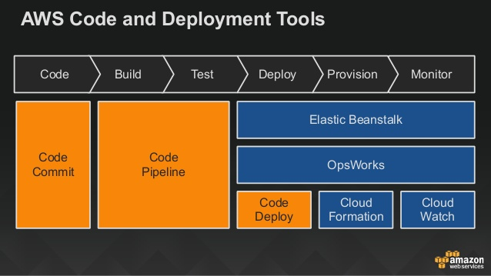
7.1: Amazon Elastic Beanstalk Amazon Development an management tool Service
Notes:
The AWS Developer Tools is a set of services designed to enable developers and IT operations professionals practicing DevOps to rapidly and safely deliver software. Together, these services help you securely store and version control your application's source code and automatically build, test, and deploy your application to AWS or your on-premises environment. You can use AWS CodePipeline to orchestrate an end-to-end software release workflow using these services and third-party tools or integrate each service independently with your existing tools.

Slide 5
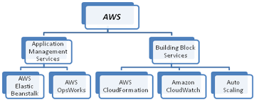
7.1: Amazon Elastic Beanstalk Amazon Development tool Service

Slide 6
7.1: Amazon Elastic Beanstalk Amazon Elastic Beanstalk
AWS Elastic Beanstalk is an easy-to-use service for deploying and scaling web applications and services .
With Elastic Beanstalk , one can easily deploy ,monitor and scale an application quickly and easily.
Supports popular programming languages such as Java, .NET, PHP, Node.js, Python and Ruby
With AWS Elastic Beanstalk, you can focus on the code and let the service manage the rest.

Slide 7
7.1: Amazon Elastic Beanstalk Amazon Elastic Beanstalk
With Elastic Beanstalk, any one retain full control over the AWS resources powering your application.
To ensure easy portability of your application, Elastic Beanstalk is built using familiar application/web servers such as Apache HTTP Server, Apache Tomcat .
Elastic Beanstalk does not restrict your choice of persistent storage and database service options.
No additional cost for Elastic Beanstalk , pay only for the underlying AWS resources that your application consumes.

Slide 8
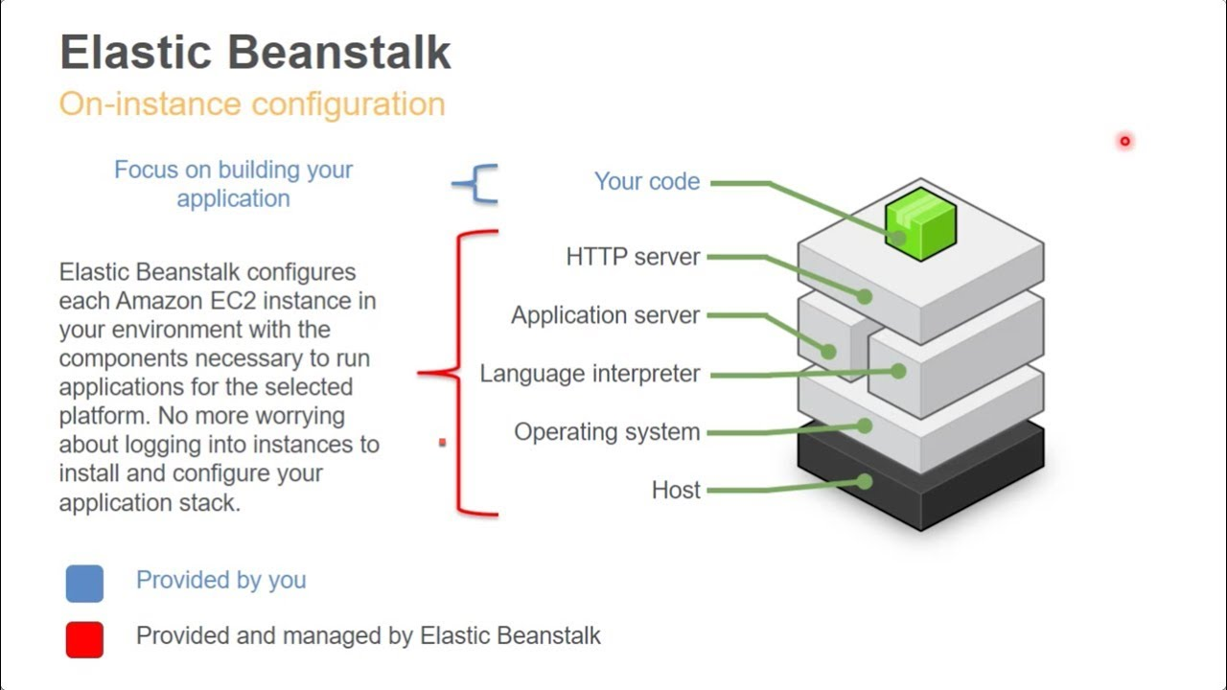
7.1: Amazon Elastic Beanstalk Amazon Elastic Beanstalk

Slide 9
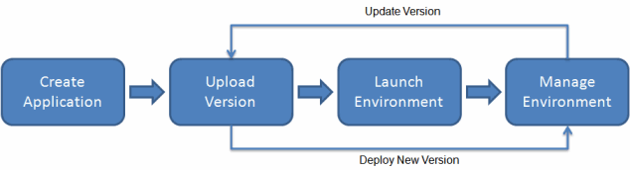
7.1: Amazon Elastic Beanstalk Elastic Beanstalk - Workflow
Notes:
you create an application, upload an application version in the form of an application source bundle (for example, a Java .war file) to Elastic Beanstalk, and then provide some information about the application. Elastic Beanstalk automatically launches an environment and creates and configures the AWS resources needed to run your code. After your environment is launched, you can then manage your environment and deploy new application versions. The following diagram illustrates the workflow of Elastic Beanstalk.

Slide 10
7.2: AWS CloudFormation AWS CloudFormation
AWS CloudFormation provides a common language for you to describe and provision all the infrastructure resources in your cloud environment.
It allows us to use a simple text file to model and provisioning an automated and secure manner, all the resources needed for your applications across all regions and accounts.
This file serves as the single source of truth for your cloud environment.
AWS CloudFormation is available at no additional charge, and you pay only for the AWS resources needed to run your applications
Notes:
A complex application on AWS can have many resources . Managing all those resources is really a big challenge.
When we manage the infrastructure , we basically use ranbox , script to create and manage everything. Here the version control and keeping changes track will be really challenging. It will be more harder when we need to replicate the entire production stack multiple time for development and testing purposes but provisioning the infrastructure task directly from a collection of scripts is simple. It will be really great , if we can create and manage the infrastructure and application task in a control and predictable way. This what the use of AWS cloud formation.

Slide 11
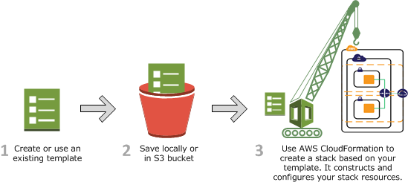
7.2: AWS CloudFormation AWS CloudFormation Workflow
Notes:
Suppose we have a template that describes an EC2 instance with a t1.micro instance type.
When we use that template to create a stack, AWS CloudFormation calls the Amazon EC2 create instance API and specifies the instance type as t1.micro.

Slide 12
7.2: AWS CloudFormation AWS CloudFormation workflow
You can design an AWS CloudFormation template (a JSON or YAML-formatted document) in AWS CloudFormation Designer or write one in a text editor.
Save the template with proper file extension (i.e. .json or . Yaml or .txt) locally or store in a S3 bucket.
Create an AWS CloudFormation stack by specifying the location of your template file i.e. either a path on your local computer or an Amazon S3 URL.

Slide 13
7.2: AWS CloudFormation AWS CloudFormation workflow
AWS CloudFormation provisions and configures resources by making calls to the AWS services that are described in your template.
After all the resources have been created, AWS CloudFormation reports that your stack has been created.
If stack creation fails, AWS CloudFormation rolls back your changes by deleting the resources that it created.
When you delete a stack, you specify the stack to delete, and AWS CloudFormation deletes the stack and all the resources in that stack. You can delete stacks by using the AWS CloudFormation console, API, or AWS CLI.
Notes:
After all the resources have been deleted, AWS CloudFormation signals that your stack has been successfully deleted.
If AWS CloudFormation cannot delete a resource, the stack will not be deleted.

Slide 14

7.3: AWS Cloudwatch Amazon Cloudwatch
It is a monitoring service for AWS cloud resources and the applications you run on AWS.
Amazon CloudWatch can be used to
collect and track metrics,
collect and monitor log files,
set alarms,
and automatically react to changes in your AWS resources.
Notes:
Amazon Cloudwatch is a monitoring service for AWS cloud resources and the applications you run on AWS.

Slide 15
7.3: AWS Cloudwatch Amazon Cloudwatch
It can monitor AWS resources such as
Amazon EC2 instances,
Amazon DynamoDB tables,
and Amazon RDS DB instances,
custom metrics generated by your applications and services,
and any log files your applications generate
It provides a reliable, scalable, and flexible monitoring solution that you can start using within minutes.
Amazon CloudWatch allows programmatically retrieve the monitoring data, view graphs, and set alarms to help you troubleshoot, spot trends, and take automated action based on the state of your cloud environment.
Notes:
It provides a reliable, scalable, and flexible monitoring solution that you can start using within minutes.
No need to set up, manage, or scale your own monitoring systems and infrastructure

Slide 16
7.3: AWS Cloudwatch Amazon Cloudwatch - Benefits
Monitor Amazon EC2
One can view metrics for CPU utilization, data transfer, and disk usage activity from Amazon EC2 instances (Basic Monitoring) for no additional charge.
Monitor Other AWS Resources
It Monitor metrics on Amazon DynamoDB tables, Amazon EBS volumes, Amazon RDS DB instances, Amazon Elastic MapReduce job flows, Elastic Load Balancers, Amazon SQS queues, Amazon SNS topics, and more for no additional charge.
Monitor Custom Metrics :
Through a Simple API request ,one can submit the Custom Metrics generated by it’s own applications and have them monitored by Amazon CloudWatch..

Slide 17
7.3: AWS Cloudwatch Amazon Cloudwatch - Benefits
Monitor and store Logs :
One can send it’s existing system, application, and custom log files to CloudWatch Logs and monitor these logs in near real-time.
Set Alarms
It helps to Set alarms on any of your metrics to send you notifications or take other automated actions.
View Graphs and Statistics
Amazon Cloudwatch Dashboards enable us to create re-usable graphs of AWS resources and custom metrics so you can quickly monitor operational status and identify issues at a glance.
Notes:
Set Alarms
It helps to Set alarms on any of your metrics to send you notifications or take other automated actions.
Exp : If You set the Alarms on EC2 instance and when the Specific Amazon EC2 metric crosses the alarm threshold , we can use Auto scaling to add dynamically any other EC2 instance or send the user a notification.

Slide 18
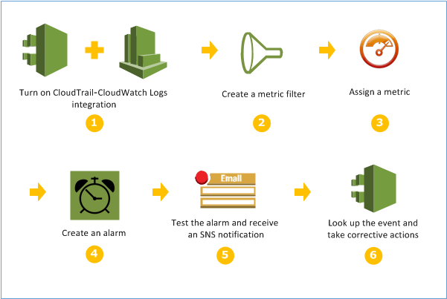
7.3: AWS Cloudwatch Amazon Cloudwatch
Notes:
Set Alarms
It helps to Set alarms on any of your metrics to send you notifications or take other automated actions.
Exp : If You set the Alarms on EC2 instance and when the Specific Amazon EC2 metric crosses the alarm threshold , we can use Autoscalling to add dynamically any other EC2 instance or send the user a notification.

Slide 19
7.3: AWS Cloudwatch Demo
Demo on:
Amazon Cloudwatch ( Steps given in Note section)
Notes:
Step 1 : Go To EC2 instance and click on Monitoring tab
Step 2: Enable the detail monitoring
Step 3 : Click on Simple Notification Service link
Step 4: In SNS Dashboard , click on Create Topic
Step 5 : After that Click on “Create Subscription”
Step 6: Now choose the Email in Protocol section and provide your email id
Step 7: Now check your mail and subscribe it
Step 8 : Now come to your EC2 instance
Step 8 : Go To Cloudwatch Dashboard and click on Alarm
Step 9 : Click on Create Alarm and choose preinstance metrics
Step 10 : Provide details and create the Alarm.
Step 11 : Now go to Cloudwatch section and see your alarm
Now transfer some files to your EC2 instance by using WinSCP S/W and wait for few minutes and see the notification in your mail.

Slide 20
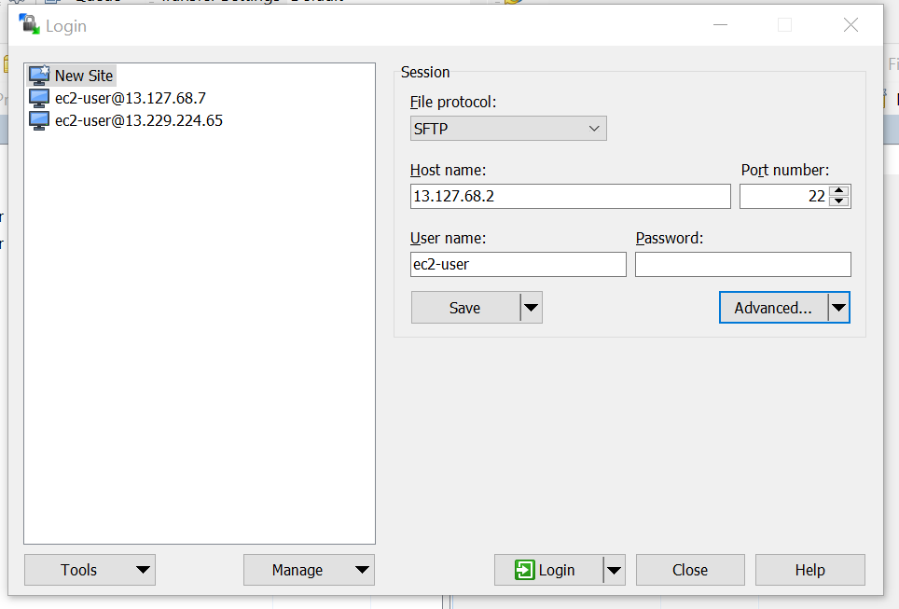
7.3: AWS Cloudwatch Demo
Demo on:
Amazon Cloudwatch ( Steps given in Note section)
Notes:
Step 1 : Go To EC2 instance and click on Monitoring tab
Step 2: Enable the detail monitoring
Step 3 : Click on Simple Notification Service link
Step 4: In SNS Dashboard , click on Create Topic
Step 5 : After that Click on “Create Subscription”
Step 6: Now choose the Email in Protocol section and provide your email id
Step 7: Now check your mail and subscribe it
Step 8 : Now come to your EC2 instance
Step 8 : Go To Cloudwatch Dashboard and click on Alarm
Step 9 : Click on Create Alarm and choose preinstance metrics
Step 10 : Provide details and create the Alarm.
Step 11 : Now go to Cloudwatch section and see your alarm
Now transfer some files to your EC2 instance by using WinSCP S/W and wait for few minutes and see the notification in your mail.
Click on advanced dropdown and select Advanced section
Go to Authentication option in left pane and select your .ppk file
Save it and upload the file.

Slide 21
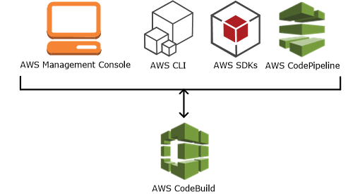
7.4: AWS CodeBuild Amazon CodeBuild
AWS CodeBuild is a fully managed build service which compiles source code, runs tests, and produces software packages that are ready to deploy.
One don’t need to provision, manage, and scale it’s own build servers.
CodeBuild scales continuously and processes multiple builds concurrently, so your builds are not left waiting in a queue
Notes:
With CodeBuild, users are charged by the minute for the compute resources they use.

Slide 22
7.4: AWS CodeBuild Amazon CodeBuild - Benefits
The benefits of Codebuild are
Fully managed Build service.
On demand
Out of the Box
Continuous Scaling
Enables Continuous Integration and Delivery
Secure
Notes:
AWS CodeBuild eliminates the need to set up, patch, update, and manage your own build servers.
AWS CodeBuild scales on demand to meet your build needs. You pay only for the number of build minutes you consume.
AWS CodeBuild provides preconfigured build environments for the most popular programming languages. All you need to do is point to your build script to start your first build
It immediately processes each build you submit and can run separate builds concurrently, which means your builds are not left waiting in a queue.
You can also integrate CodeBuild into your existing CI/CD workflow
CodeBuild is integrated with AWS Identity and Access Management(IAM), so you can assign user-specific permissions to your build projects.

Slide 23
7.5: AWS CodeDeploy Amazon CodeDeploy
AWS CodeDeploy is a service that automates software deployments to a variety of compute services including Amazon EC2, on-premises instances.
AWS CodeDeploy can deploy application content that runs on a server and is stored in Amazon S3 buckets, GitHub repositories, n-premises.
It rapidly release new features and Avoid downtime during application deployment.
AWS CodeDeploy works with various systems for configuration management, source control, continuous integration, continuous delivery, and continuous deployment.
Notes:
AWS CodeDeploy is a service that automates software deployments to a variety of compute services including Amazon EC2, on-premises instances.

Slide 24
7.5: AWS CodeDeploy Amazon CodeDeploy - Benefits
Server and serverless applications
Automated deployments.
It Minimize downtime.
Stop and roll back
Centralized control
Easy to adopt
Notes:
AWS CodeDeploy lets us deploy both traditional applications on servers and applications that deploy a serverless AWS Lambda function version.
It fully automates the application deployments across your development, test, and production environments. AWS CodeDeploy scales with your infrastructure so that you can deploy to one instance or thousands.
AWS CodeDeploy helps maximize your application availability.
If there is any error , one can automatically or manually stop and roll back deployments .
You can launch and track the status of your deployments through the AWS CodeDeploy console or the AWS CLI.
AWS CodeDeploy is platform-agnostic and works with any application

Slide 25
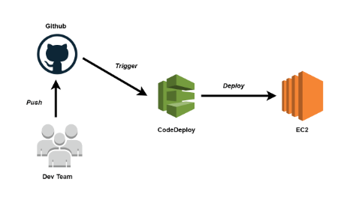
7.5: AWS CodeDeploy AWS Codedeploy

Slide 26
Summary
In this lesson, you have learnt:
Amazon Elastic Beanstalk
AWS CloudFormation
Amazon Cloudwatch
Codebuild
CodeDeploy

Slide 27
Review – Questions
Question 1: ________________ is a monitoring service for AWS cloud resources and the applications you run on AWS.
Question 2 : _____________ AWS service provides a common language for user to describe and provision all the infrastructure resources in your cloud environment.
Notes:
Answers for the Review Questions:
Answer 1: AWS cloudwatch
Answer 2: AWS CloudFormation

Slide 28
Review – Questions
Question 3 : _______________AWS service Supports popular programming languages such as Java, .NET, PHP, Node.js, Python and Ruby
Question 4: Which of the followings are not the AWS deployment and management service ?
Option 1 : Amazon EBS
Option 2 : Amazon CodeBuild
Option 3 : Amazon Codedeploy
Option 4 : Amazon EC2
Notes:
Answers for the Review Questions:
Answer 3 : Amazon Elastic Beanstalk
Answer 4: Option 1 and Option4

